Slide 1
Sharing Business Common Logic Between Components
X
By : Ridoan Saleh Nasution
17.00 - Finish (SGT)
May 29th, 2020
(Live on Teams)
AIA Singapore

Slide 2
About Me
Name : Ridoan Saleh Nasution
Job Title : Fullstack JavaScript Developer
Office : Batam, Indonesia

Slide 3
Three Ways
Render Props
HOC
Custom Hooks

Slide 4
Render Props
The term “render prop” refers to a technique for sharing code between React components using a prop whose value is a function.

Slide 5
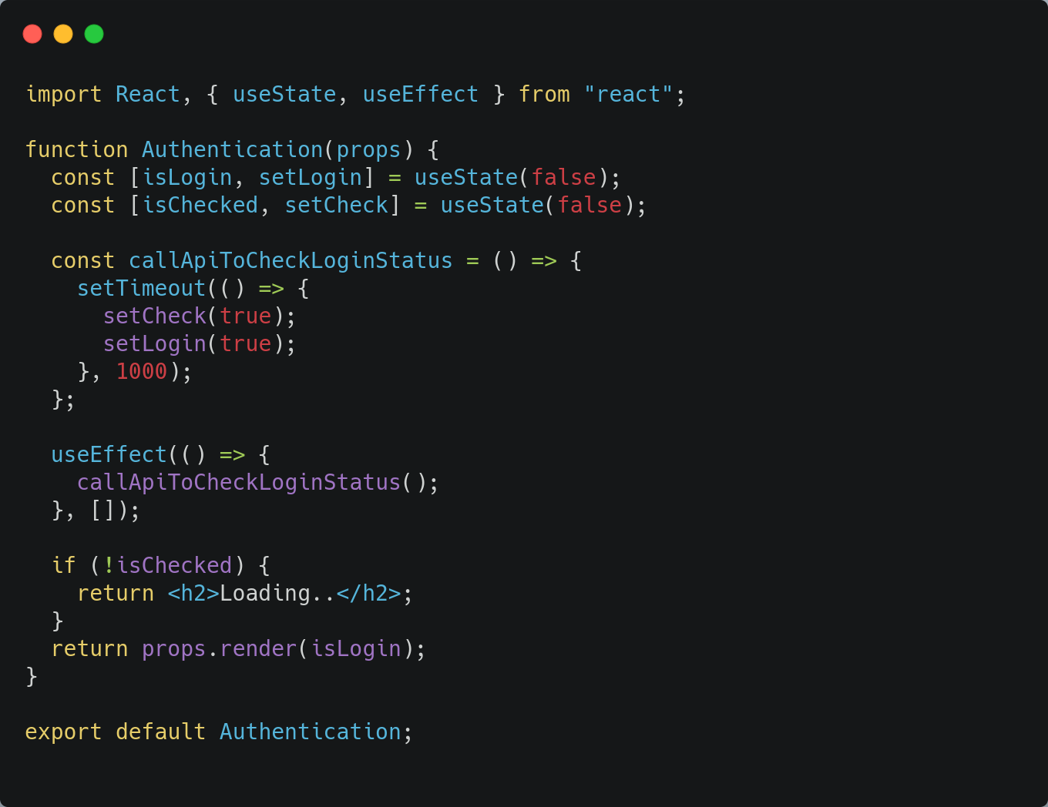
Parent Component - Authentication

Slide 6
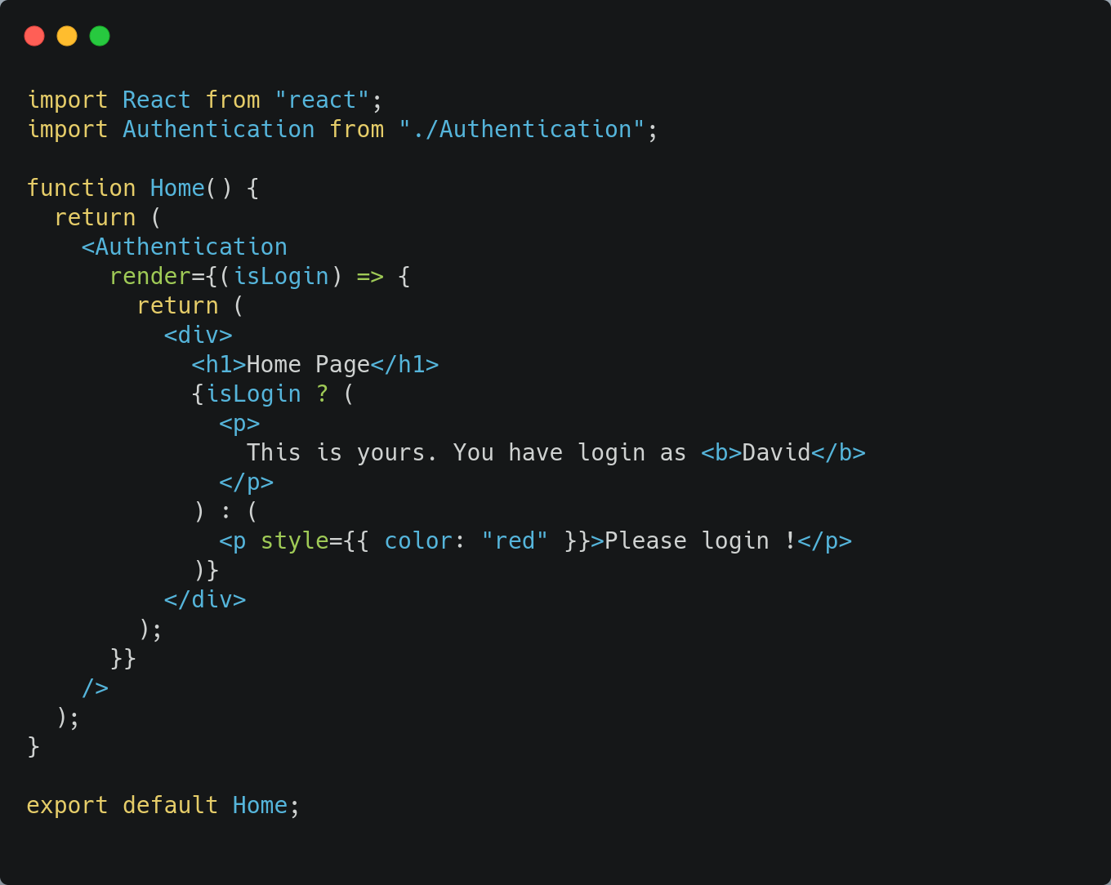
Child Component - Home

Slide 7
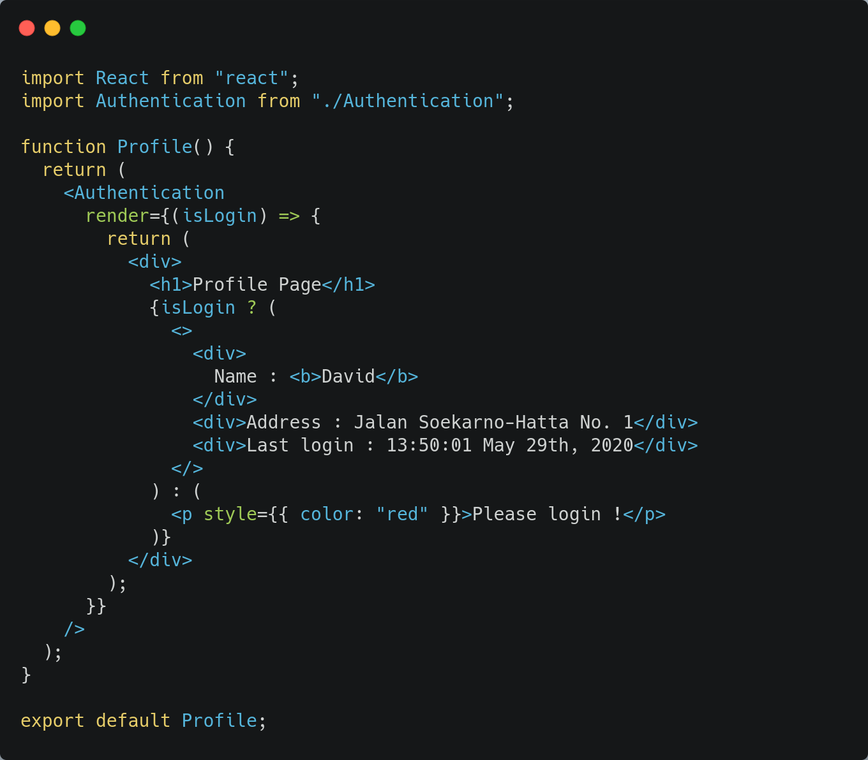
Child Component - Profile

Slide 8
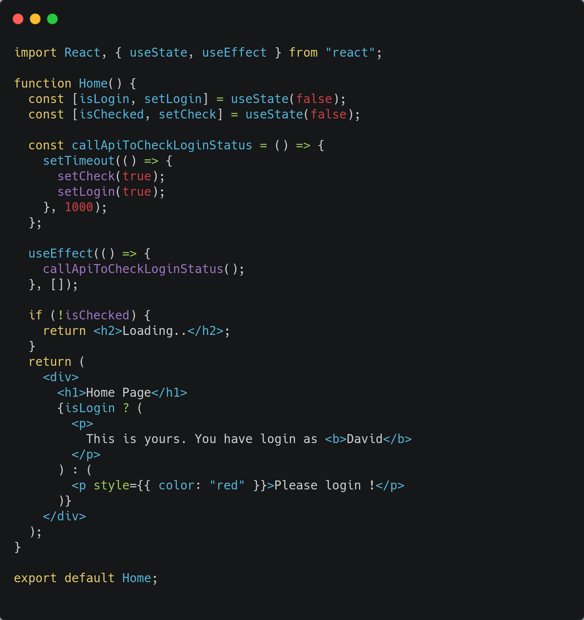
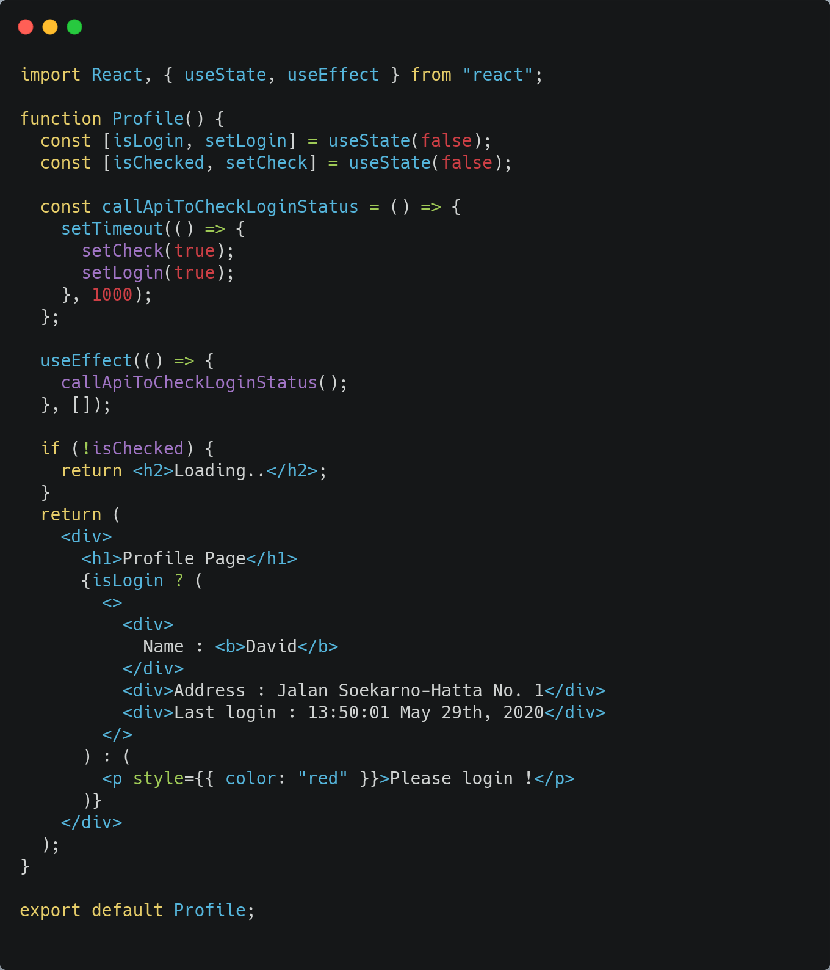
Without Render Props

Slide 9
Higher-Order Components (HOC)
A higher-order component (HOC) is an advanced technique in React for reusing component logic.

Slide 10
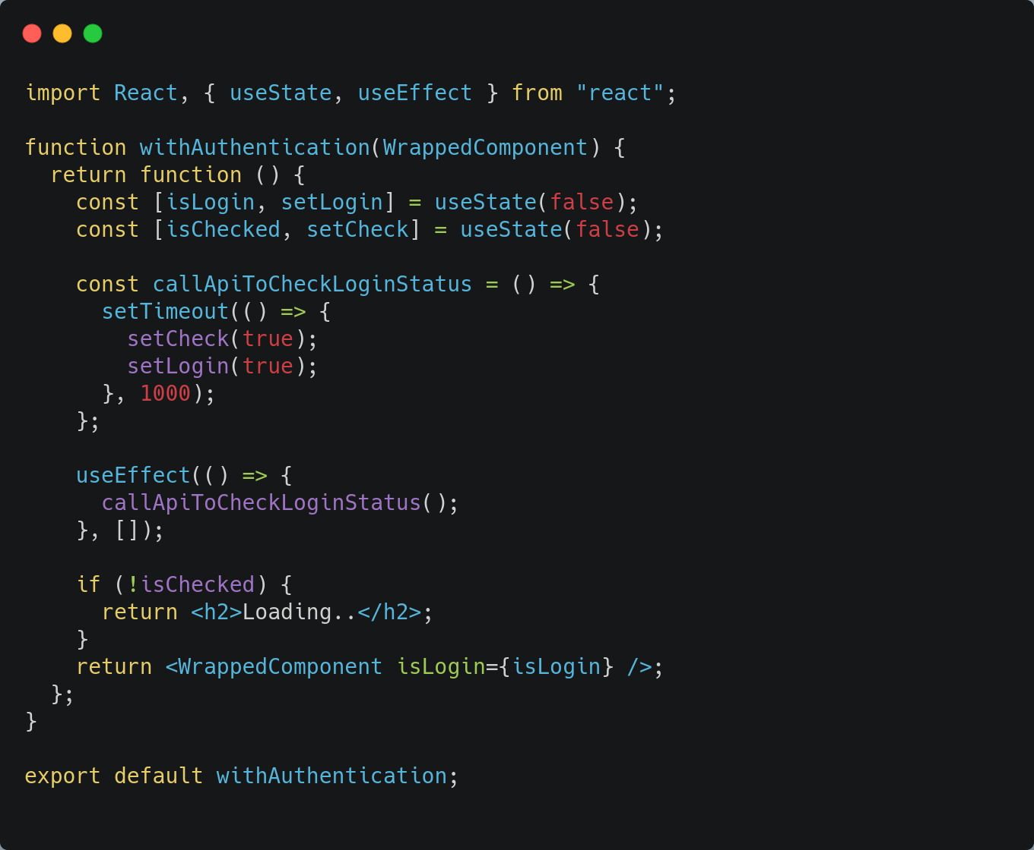
Parent Component - withAuthentication

Slide 11
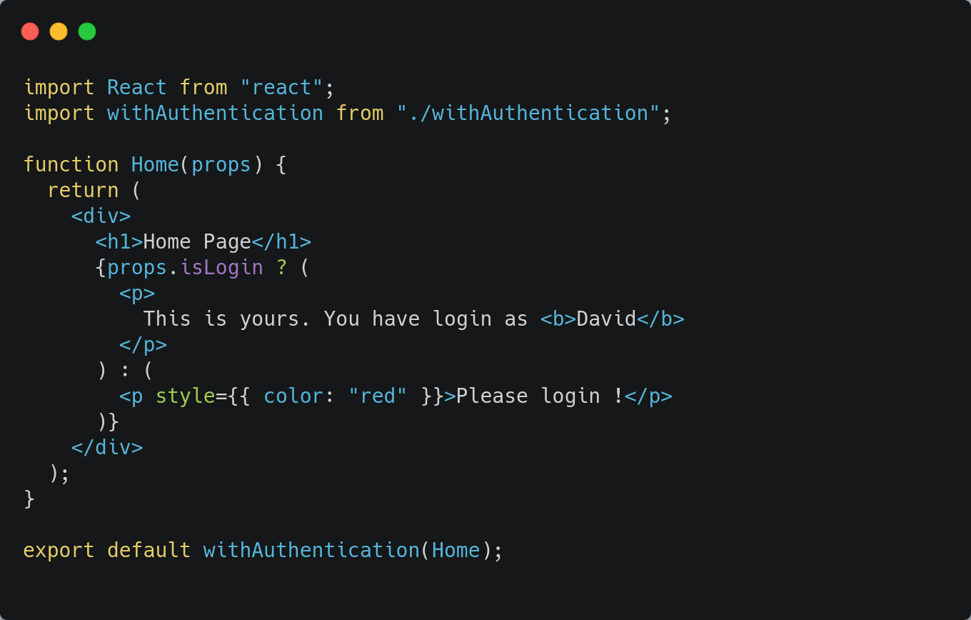
Child Component - Home

Slide 12
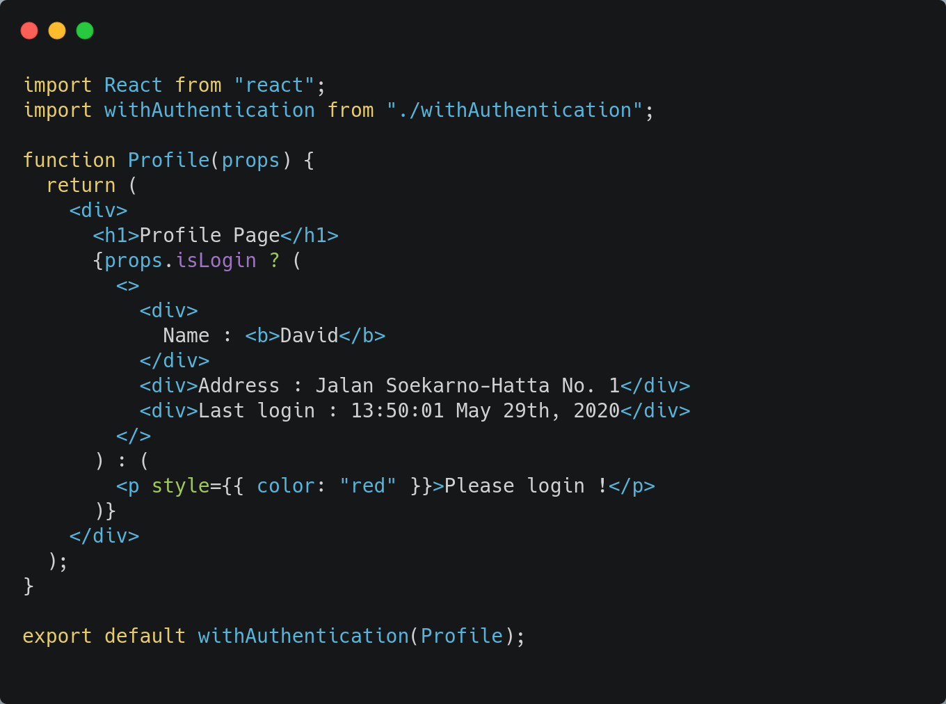
Child Component - Profile

Slide 13
Custom Hooks
Hooks are a new addition in React 16.8. They let you use state and other React features without writing a class.
Custom Hook is a reusable function that enable developer extract component logic by using Hooks feature.

Slide 14
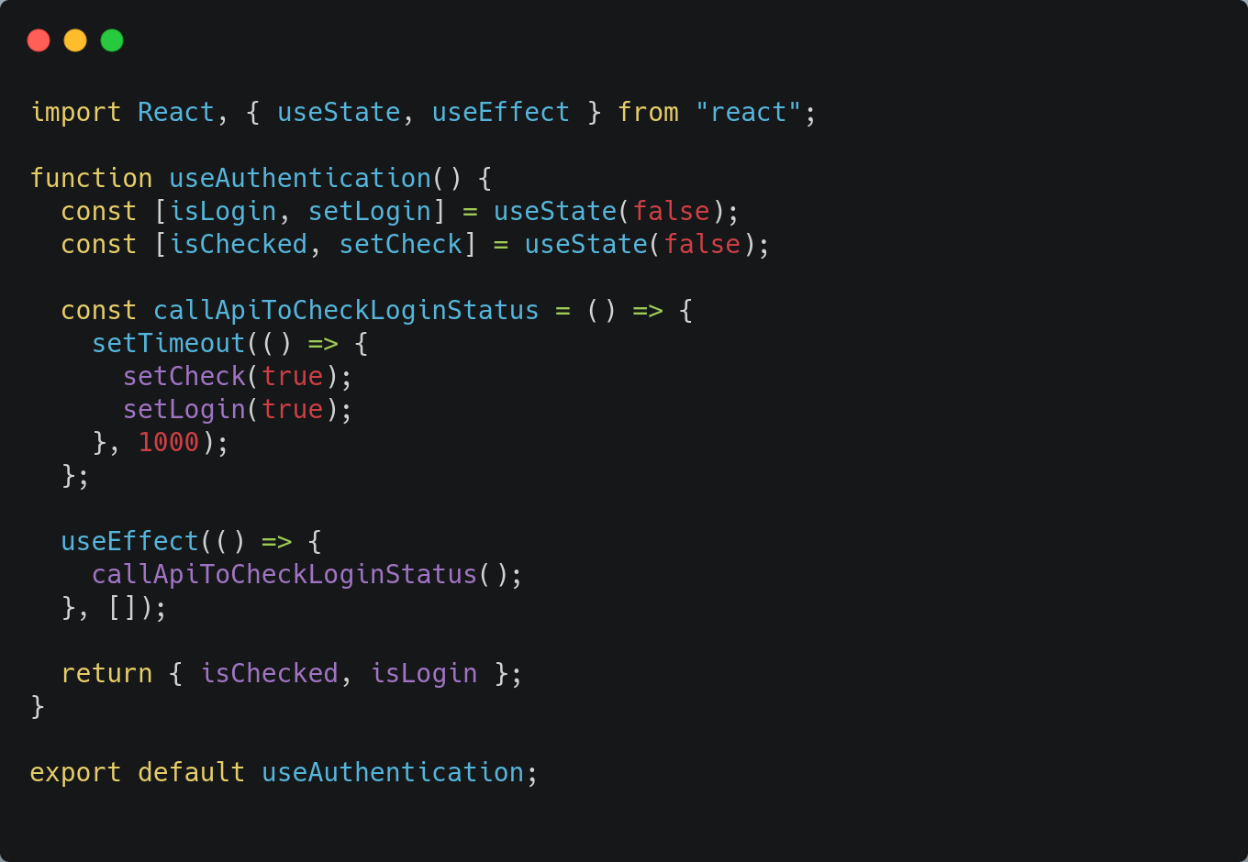
Parent Component - useAuthentication

Slide 15
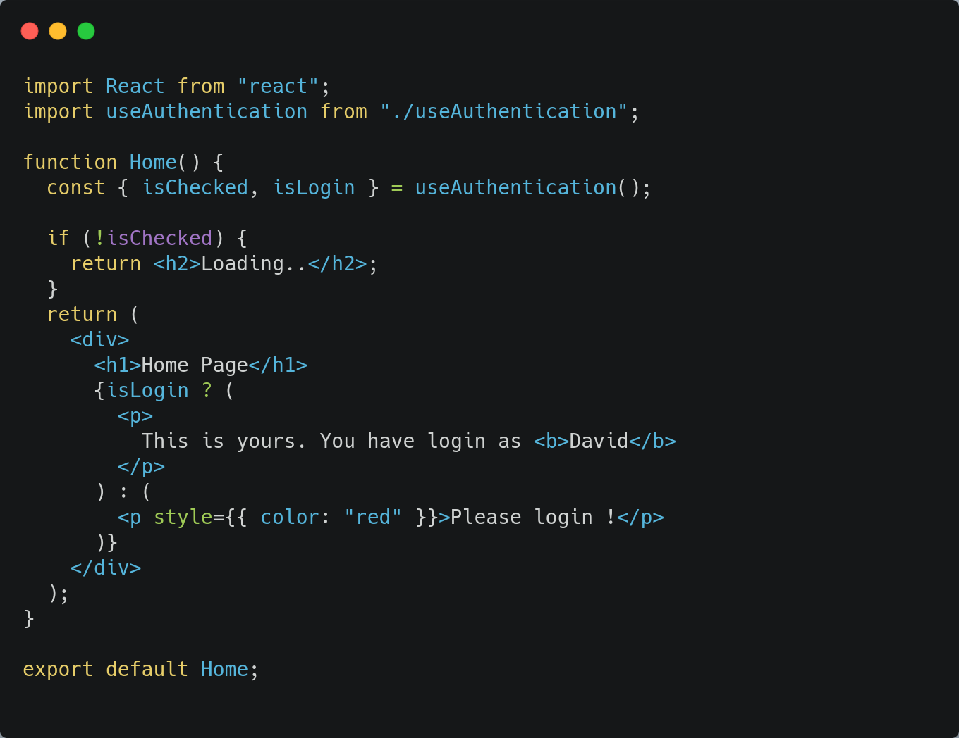
Child Component - Home

Slide 16
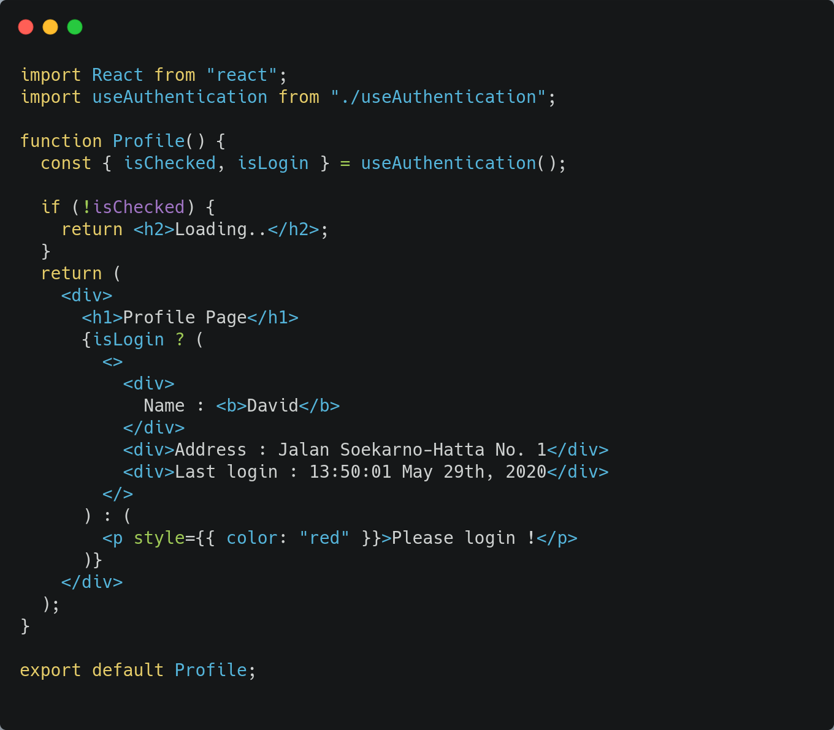
Child Component - Profile

Slide 17
